Slide 1

Central Bank of the United Arab Emirates:
Liquidity Forecasting, Concluding Meeting
26th JULY 2021
Romain Lafarguette and Anastasios Panagiotelis IMF Technical Assistance Mission
Central Bank Operations Division

Slide 2
Overview
  Present forecasting results and main recommendations for four variables in UAE:
    Currency in Circulation (CiC),
    State Account Balance (SAB).
    Net Foreign Assets (NFA)
    Net Liquidity Injection (NFA-(CIC+SAB))
  A diverse range of models have been tested and compared using out-of-sample performance metrics over an expanding window.

Slide 3
Outline
  Empirical Setup
  Results
  Forecast Reconciliation
  Concluding remarks

Slide 4
Empirical Setup
  Forecast all variables at the end of the RMP.
  Forecast from 14-day ahead to 1-day ahead.
    Will emphasise 14-day ahead results.
  Leads to 52 evaluation periods with 10 forecasts.
  Produce point forecasts and 80% and 95% prediction intervals.
    Will emphasise 95% prediction intervals.
  Consider model averaging and forecast reconciliation.

Slide 5
Modelling approach
  For CIC and SAB consider regression + ARIMA models
    Structural breaks
    Seasonal Terms
    Holiday effects
  Also consider ETS and TBATS model
  For NFA and Net Liquidity
    GARCH
    eGARCH
    GJR GARCH

Slide 6
Selecting regression
  Fit all combinations of
    Day of Week dummies
    Day of Month, Day of Quarter, Day of Year (Civic Calendar), Day of Year (Religious Calendar) – all using Fourier terms.
    Dummies for Structural break
    Holiday terms.
  Selected ARIMA order using auto.arima function.
  Choose regression specification using Akaike Information Criterion

Slide 7
Regression models chosen
Term | CIC | SABDay
Day of Week | YES | YES
Day of Month | NO | NO
Day of Quarter | NO | NO
Day of Year (Gregorian) | NO | NO
Day of Year (Hijri) | NO | NO
Covid | YES | YES
Holiday | YES | NO

Slide 8
Model Selection and Averaging
  The regression model was kept fixed for the whole evaluation period.
  However, the best order of the ARIMA model was selected for each evaluation period.
  Similarly, the specification within the ETS class was selected for each evaluation period.
  Once the best model for each family was selected, model averaging was carried out.
  Model averaging was done via a simple average.

Slide 9
Outline
  Empirical Setup
  Results
  Forecast Reconciliation
  Concluding remarks

Slide 10
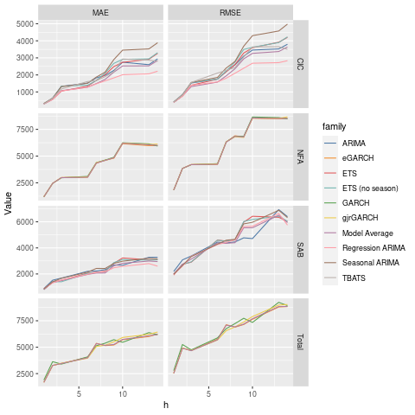
Point Forecasting Results

Slide 11
Relative Root Mean Square Error (14-day ahead)
Method | CIC | SAB
ARIMA | 1.044 | 1.077
Seasonal ARIMA | 1.369 | 1.065
Regression + Seasonal ARIMA | 0.779 | 0.968
ETS | 1.155 | 1.014
ETS (no seasonality) | 1.163 | 1.016
TBATS | 0.961 | -
Model Average | 1.000 | 1.000

Slide 12
Root Mean Square Error (14-day ahead)
Method | NFA | Total
GARCH | 0.995 | 1.009
eGARCH | 0.999 | 1.000
GJR GARCH | 1.017 | 1.021
Model Average | 1.000 | 1.000

Slide 13
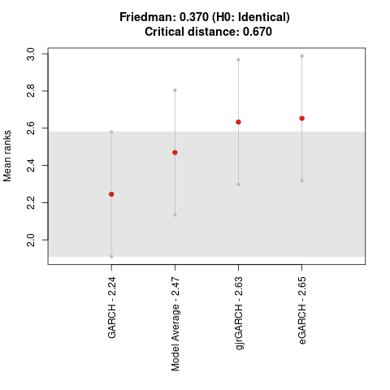
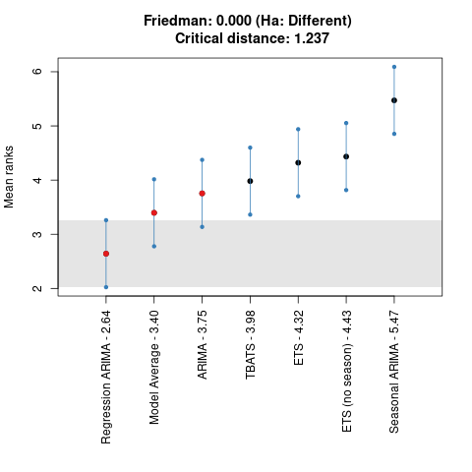
Nemenyi plot (RMSE)

Slide 14
Point Forecasting Summary
  Regression models with ARIMA work well for CIC and SAB
  All models work equally well for NFA and the Total
    Not surprising since the mean is hard to forecast.
  This story changes a little at shorter horizons
    For example, ETS does better at short horizons for CIC.
  We must also look at the performance of interval forecasts.

Slide 15
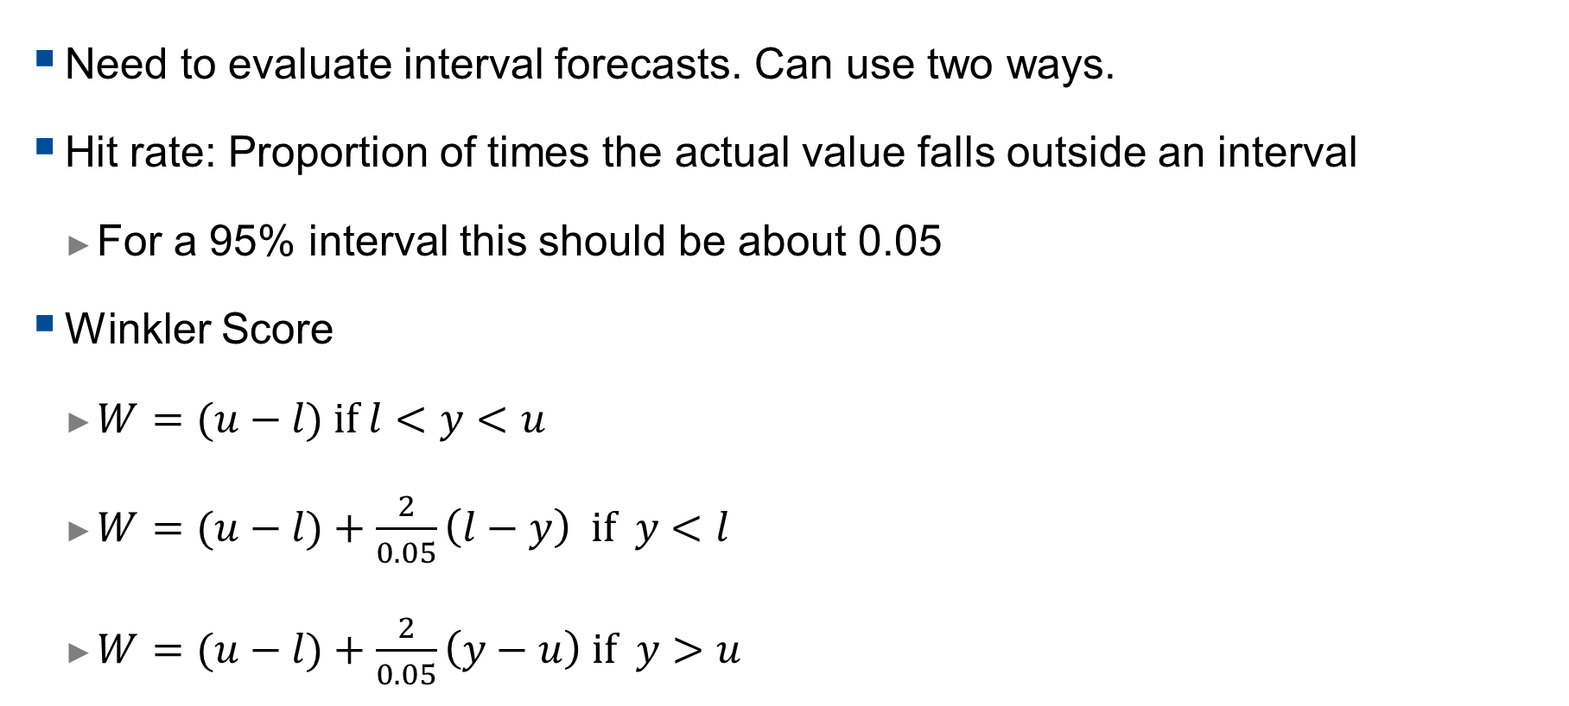
Interval Forecast
  Need to evaluate interval forecasts. Can use two ways.
  Hit rate: Proportion of times the actual value falls outside an interval
    For a 95% interval this should be about 0.05
  Winkler Score
    $W=(u−l) if l<y<u$
    $W=(u−l)+\frac{2}{0.05}\left(l−y\right) if y<l$
    $W=(u−l)+\frac{2}{0.05}\left(y−u\right) if y>u$

Slide 16
Hit Rates (14-day ahead)
Series | Model | Hit Rate (80% interval) | Hit Rate (95% Interval)
Total | eGARCH | 0.2264 | 0.0566
CIC | Reg. Seas. ARIMA | 0.1887 | 0.0377
SAB | Reg. + Seas. ARIMA | 0.0943 | 0.0566
NFA | eGARCH | 0.2075 | 0.0943

Slide 17
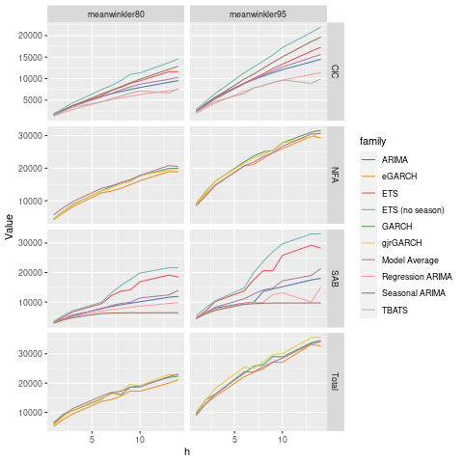
Winkler Score

Slide 18
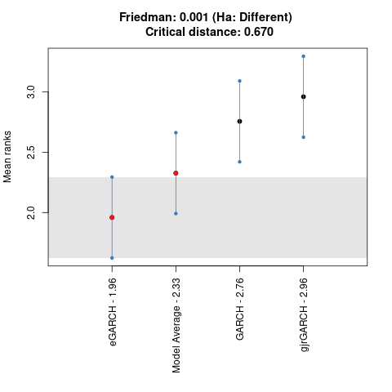
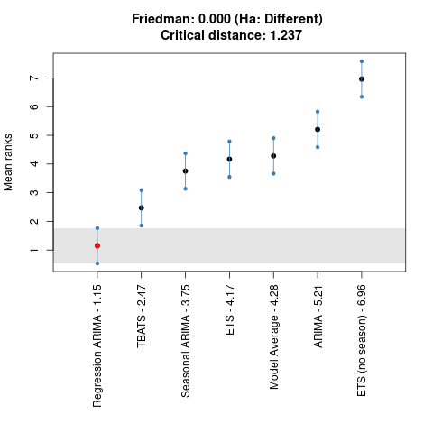
Nemenyi Plot (95% Winkler Score, 14-day ahead)

Slide 19
Outline
  Empirical Setup
  Results
  Forecast Reconciliation
  Concluding remarks

Slide 20
Forecast Reconciliation
  Use the best model family for each series.
  Will show results for Net Liquidity Position only
  Use the following Methods
    Base (ignore CIC,SAB and NFA forecasts)
    Bottom Up (ignore Net Liquidity forecast)
    OLS Reconciliation
    MinT Reconciliation (accounts for dependence in forecast errors)

Slide 21
Reconciliation Results (14-day ahead)
Method | RMSE | Winkler Score (95%) | Hit Rate
Base | 8844.6 | 32686.3 | 0.057
Bottom Up | 8895.0 | 29581.7 | 0.094
OLS | 8814.0 | 26275.5 | 0.113
MinT | 8817.3 | 27369.0 | 0.094

Slide 22
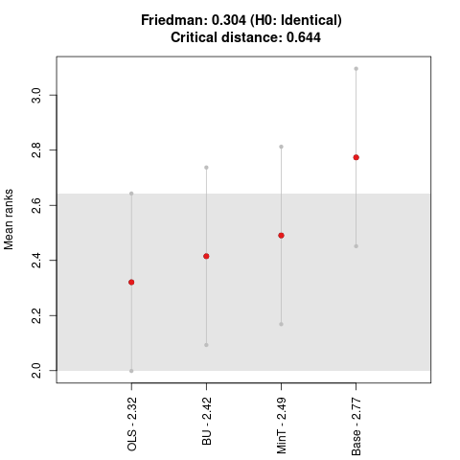
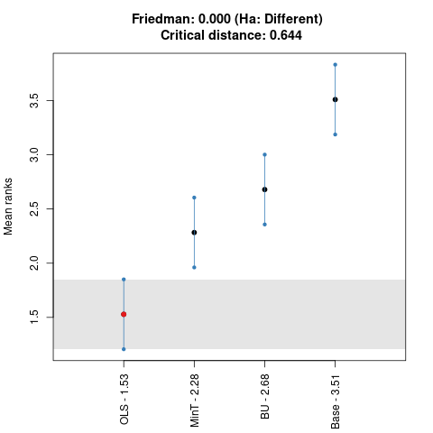
Nemenyi Plots (RMSE and Winkler, 14-day ahead)

Slide 23
Summary
  For point forecasts reconciliation does not significantly improve over Base forecasts or Bottom Up forecasts.
  For interval forecasts there is a significant improvement in the Winkler Score when reconciliation is carried out.
  This arises since OLS reconciliation gives narrower prediction intervals.
    Roughly 40bn AED instead of 55bn AED
  These intervals may not be as well calibrated as the base forecasts as indicated by the hit rate.

Slide 24
Outline
  Empirical Setup
  Results
  Forecast Reconciliation
  Concluding remarks

Slide 25
Main Recommendations
  Forecast autonomous factors using:
    Seasonal ARIMA models with regression terms for structural breaks (CIC and SAB), day of week dummies (CIC and SAB) and holidays (CIC).
    The eGARCH model for NFA and Net Liquidity.
  Reconcile using the OLS method.
  Continue to produce and assess interval forecasts.
    These methods may provide scope to reduce Reserve Requirements in the future.

Slide 26
Future Investigations
  Build capacity for forecasting of autonomous factors:
    Investigate more volatility models (including stochastic volatility models). These can be used for forecasting the Net Liquidity and NFA.
    Different approaches to model averaging and forecast combination.
    Approaches to forecast reconciliation that use bootstrapping.
    Develop a metric for evaluating prediction intervals (other than Winkler Score) that is tailored to the concerns of Central Banks.
    Collect more data to evaluate forecasting methods.

